Slide 1
Effect of ENSO on the Atlantic Hurricane Season
Evan David Wellmeyer

Slide 2
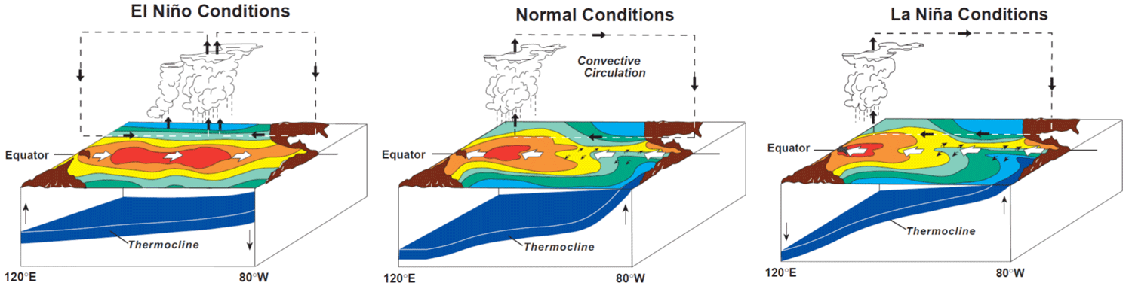
The El Nino Southern Oscillation
Three main components – three outcomes
Source: NOAA/PMEL/TAO
Notes:
Quick overview of ESNO, it can be characterized by three main components.
There is the obvious SST, there is the Atmospheric circulation and the slope of the thermocline
Changes in atmospheric circulation induce movement (or non movement) of surface waters across the pacific
This changes the slope of the thermocline and increases or reduces cold water upwelling according to phase
As result we have changes in SST across the Pacific

Slide 3
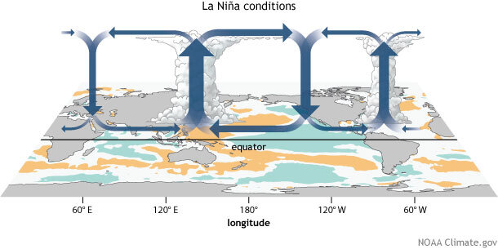
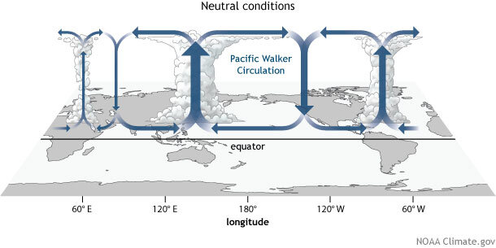
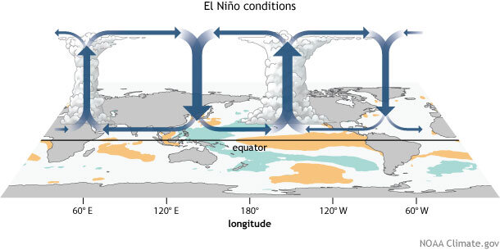
ENSO – Walker Circulation
Notes:
The equatorial atmospheric circulation is called the Walker circulation, which has a form under “neutral’ conditions on the left
During La Nina conditions this circulation is intensified
And during El Nino conditions the circulation is weakened as well as shifted
(After understanding the relationship between ENSO and Atlantic TC activity, everything can be explained sufficiently well from these figures alone)

Slide 4
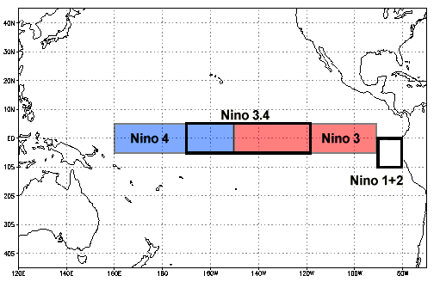
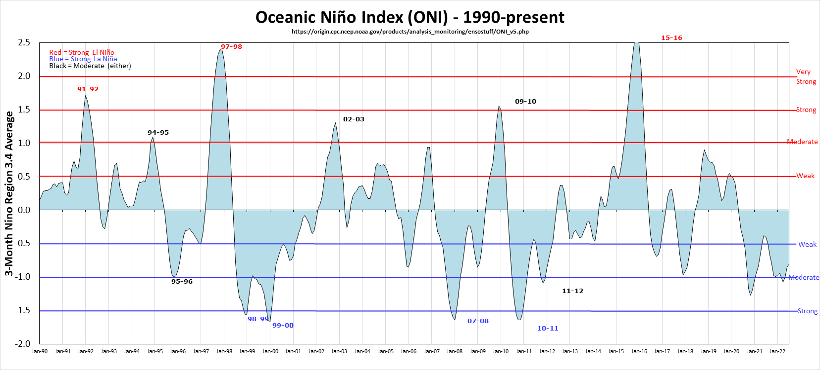
Niño 3.4 (5N-5S, 170W-120W)
ONI (5N-5S, 170W-120W): The ONI uses the same region as the Niño 3.4 index. The ONI uses a 3-month running mean, and to be classified as a full-fledged El Niño or La Niña, the anomalies must exceed +0.5C or -0.5C for at least five consecutive months. This is the operational definition used by NOAA.
Notes:
The ENSO phase can be measured in a variety of ways using predefined domains, inside of which the SST and the corresponding anomaly can be taken.
Each domain also has a predefined temporal averaging scheme to produce the index for the given domain.
The ONI uses the Nino 3.4 domain with a 3-month running average, where the phase must surpass +- 0.5C anomaly for 5 consecutive months to be considered full El Nino or La Nina
On the right is an example of this which is the ONI from NOAA showing the operational ONI from 1990 to present.

Slide 5
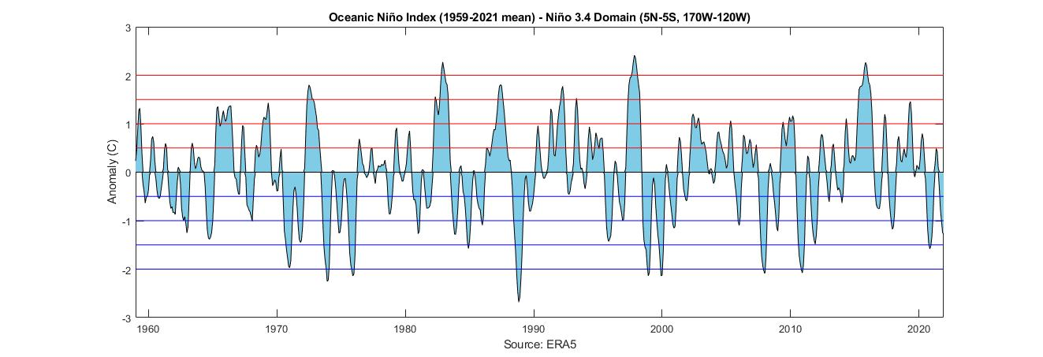
Niño 3.4 Domain – ERA5 Reanalysis
Notes:
Reproduction of ONI from global reanalysis – ERA5 chosen
ERA5 extends from 1959-present, 2022 not finished at the time of analysis
The timeseries looks appropriate, but to add some perspective you can compare with the NOAA ONI data set on next slide

Slide 6
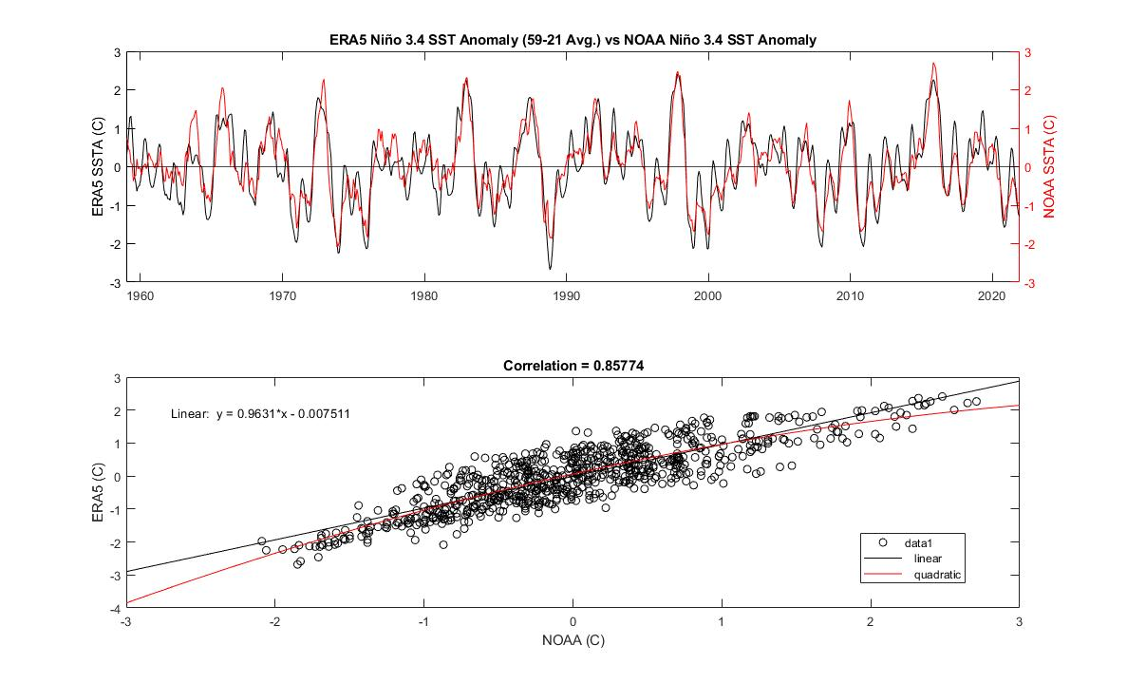
Notes:
Comparison of the reanalysis ONI with the observational ONI from NOAA
The timeseries on the top is best reproduced during strong phases, but departs in many neutral or transitionary areas (as well as other areas)
However, the correlation between the timeseries is quite good.
Note: NOAA uses background climate data to adjust the ONI, taking into account annual changes which would explain well departures such as those seen around years 2000-2003.

Slide 7
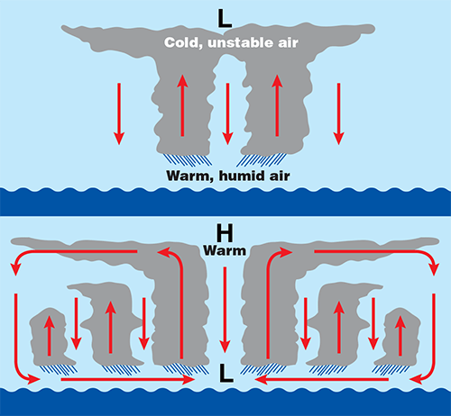
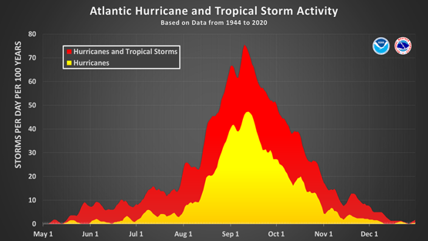
Tropical Cyclones - Cyclogenesis
Warm ocean waters (26+ C)
High lapse rate – potentially unstable to moist convection
Mid-tropospheric moisture
5+ degrees of latitude – Minimum Coriolis parameter
Near-surface disturbance – Vorticity and Convergence
Low vertical wind shear (200-850 mb)
Source: scijinks.gov
Notes:
1. Warm ocean waters (of at least 26.5 °C) throughout a sufficient depth (unknown how deep, but at least on the order of 50 m). Warm sea surface temperatures (SSTs) are necessary to fuel the heat engine of the tropical cyclone.
2. An atmosphere which cools fast enough with height such that it is potentially unstable to moist convection. It is the precipitating convection typically in the form of thunderstorm complexes which allows the heat stored in the ocean waters to be liberated for tropical cyclone development.
3. Relatively moist layers near the mid-troposphere. Dry mid levels are not conducive for allowing the continued development of widespread thunderstorm activity because entrainment into the thunderstorms dries and cools the rising parcel, reducing buoyancy.
4. A minimum distance of around 500 km from the equator for non-negligible amounts of the Coriolis force to provide for near gradient wind balance to occur. Without a substantial Coriolis force, inflow into the low pressure is not deflected to the right (to the left in the Southern Hemisphere) and the partial vacuum of the low is quickly filled.
5. A pre-existing near-surface disturbance with sufficient vorticity and convergence. Tropical cyclones cannot be generated spontaneously. To develop, they require a weakly organized system with sizable spin and low-level inflow.
6. Low values (less than about 10 ms-1) of vertical wind shear between the 850 and 200 mb levels. Vertical wind shear is the magnitude of wind change with height. Large values of vertical wind shear disrupt the incipient tropical cyclone and can prevent genesis, or, if a tropical cyclone has already formed, large vertical shear can weaken or destroy the tropical cyclone by interfering with the organization of deep convection around the cyclone center (DeMaria 1996).
Process:
Water vapor from the evaporation of warm ocean waters condense forming clouds.
Cloud formation causes release of latent heat into the air. Warm air rises building the cloud column.
The process of evaporation and condensation continues, causing the storm to grow.
As the storm grows, the upper-level pressure and air temperature increase, causing air movement away from the central upper level high (anticyclonic)
The upper-level high induces a low-pressure center at the surface, and the storm begins to rotate (cyclonic).
If conditions allow, the storm will grow, and an eye will develop.

Slide 8
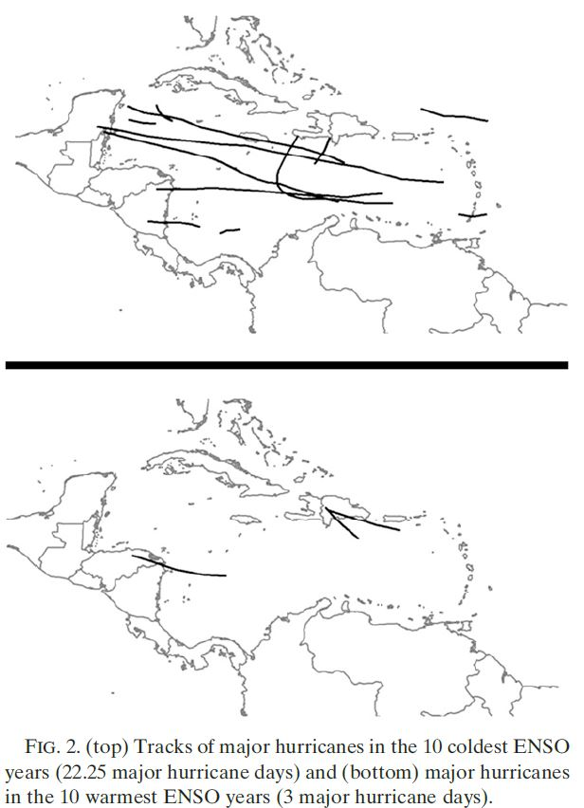
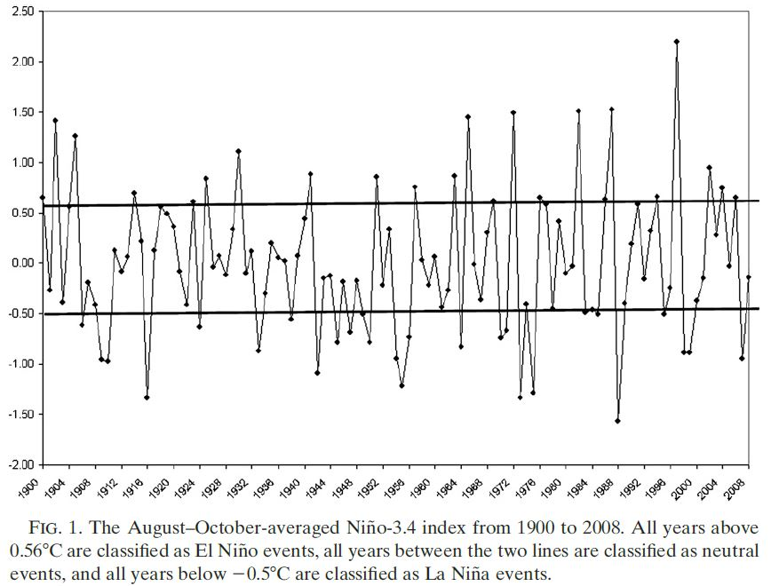
Klotzbach, 2011 (1)
Notes:
Klotzbach observes ESNO phases occurring during August through October (ASO)
Irrelevant to look at the ENSO/teleconnection relationship for months outside peak hurricane season
On the left we have the timeseries for ASO averaged Niño 3.4 index (Only values from peak hurricane season)
On the right he plots the storm tracks of major hurricanes (Category 3+) occurring during the 10 coldest ENSO years (top) and the 10 warmest ENSO years (bottom)

Slide 9
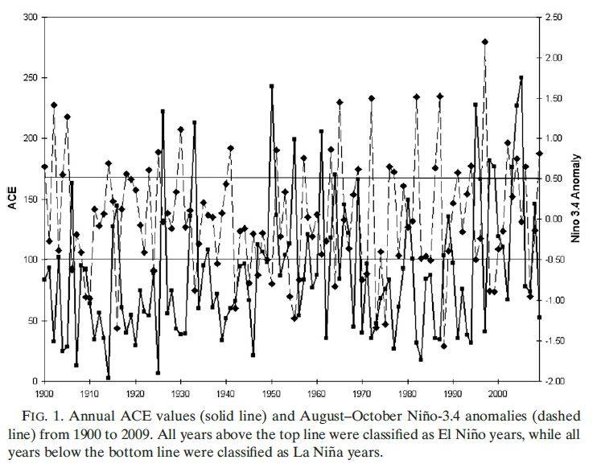
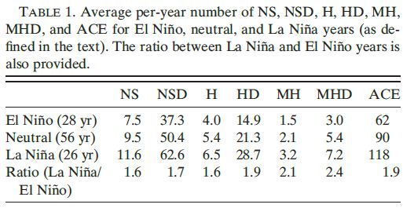
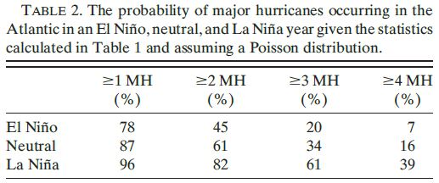
Klotzbach, 2011 (2)
Notes:
Klotzbachs second publication, they give us more statistical information about the ENSO/Hurricane relationship
Accumulated Cyclone Energy (ACE) is a running sum through the season, TCs contribute via wind speed every 6 hours when meeting a certain threshold
On the right we have the number of storms during each phase, with many more storms occurring during cold phases than warm phases, and a higher ACE for La Nina
On the bottom we have the probability of the number of major hurricanes occurring based on ENSO phase

Slide 10
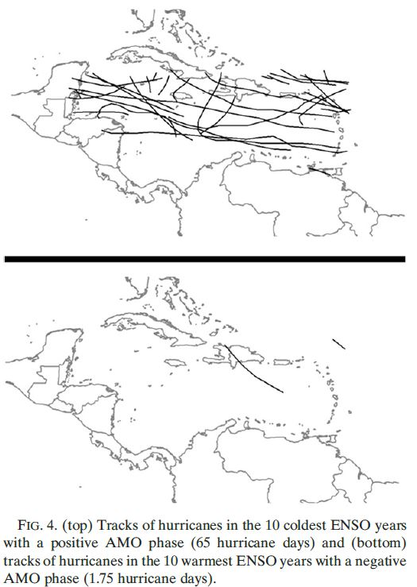
Klotzbach, 2011 (1)
Notes:
ESNO is not the sole contributor to Hurricane season variability. The variability becomes clearer when coupling multiple climate modes
On the left is the figure from before considering only ENSO
On the right is the 10 coldest ENSO years with positive AMO phase (top), 10 warmest ENSO years with a negative AMO phase (bottom)

Slide 11
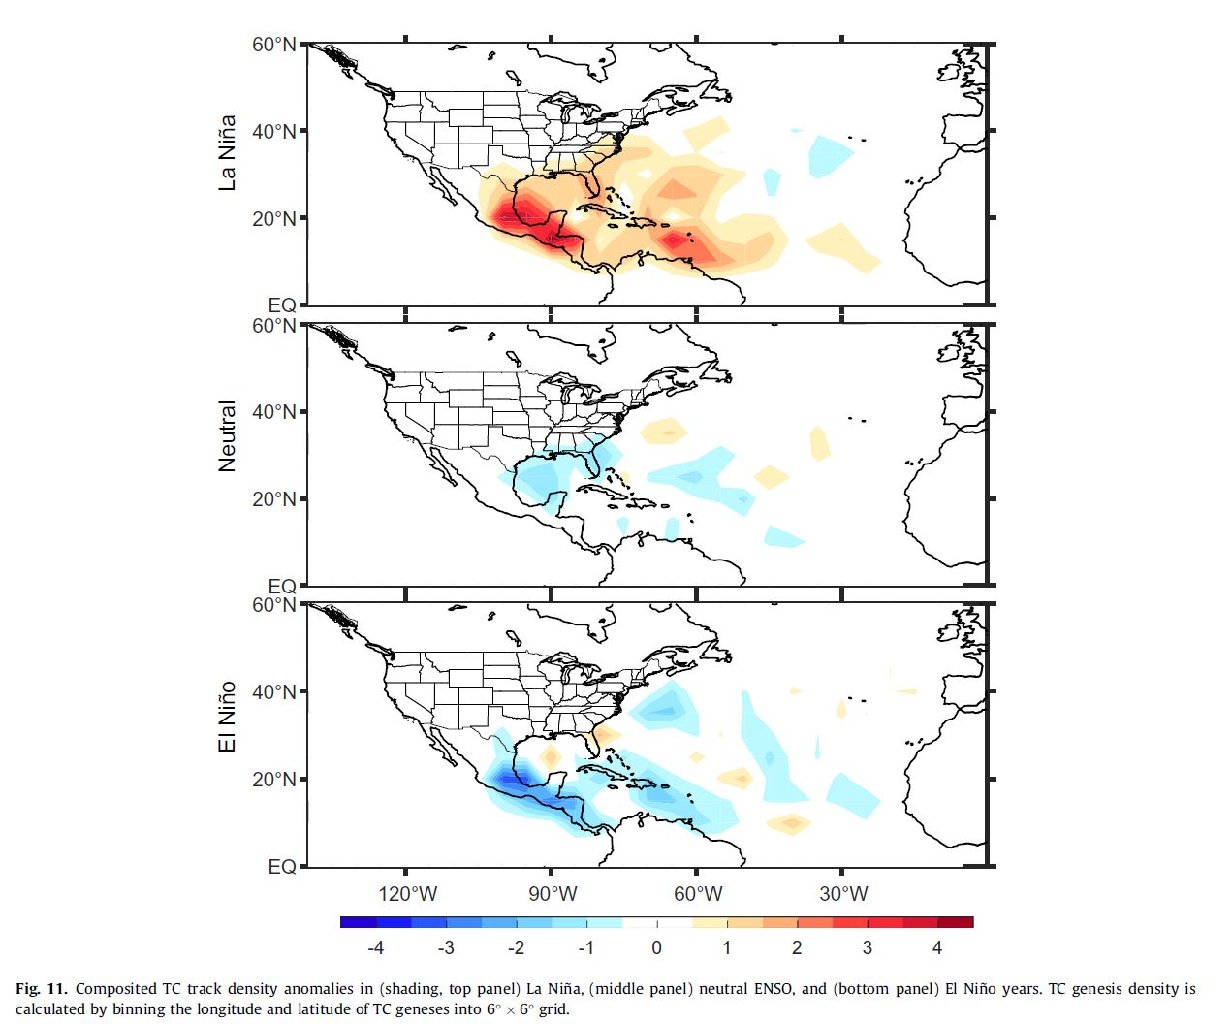
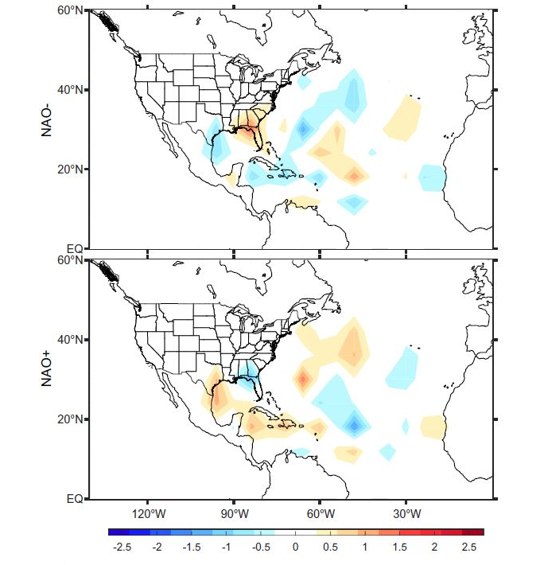
Aryal et al. (2018)
Notes:
Aryal et al. shows TC track density anomalies during both ENSO phases as well as NAO phases.
Unfortunately, they do not correlate these phases in their study for joint contribution as Klotzbach has done with the AMO.
However, one could hypothesize that the result would be similar.

Slide 12
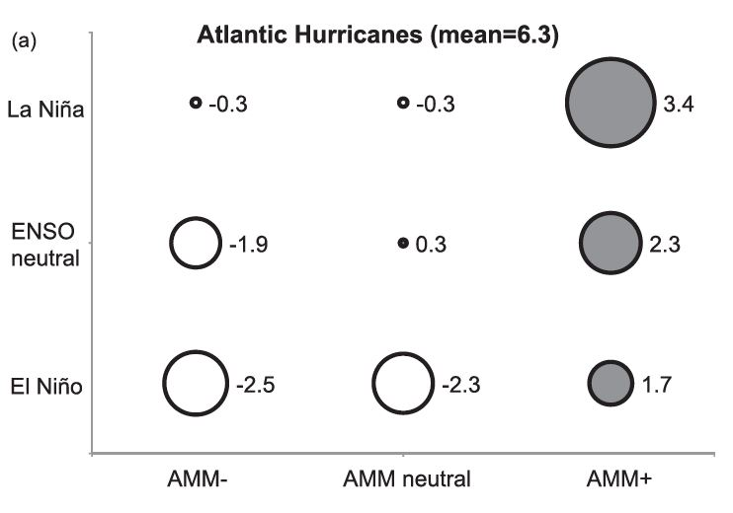
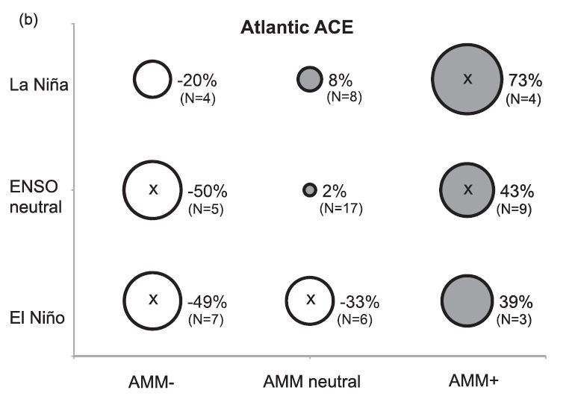
ENSO and AMM – Atl. Hurricanes
Source: Patricola et al., 2014
Notes:
Average deviation from the 1950–2012 mean in observed number of Atlantic (a) hurricanes and (b) major (category 3, 4, and 5) hurricanes from HURDAT2 for composites according to ASO averaged AMM and Ni~no-3.4 indices, defined as in Fig. 2b. Deviation is proportional to the diameter of the circle (positive shaded gray) and listed to its right. The 1950–2012 mean is in parentheses.
Deviation from the 1950–2012 mean in observed seasonal Atlantic accumulated cyclone energy (ACE) (10^4 kt2) from HURDAT2, with the percentile of the observed ASO averaged AMM and Ni~no-3.4 indices. Deviation in ACE is proportional to the diameter of the circle, with positive shaded gray and negative shaded white. The gray axes represent the 50th percentiles, and the black dashed lines represent the 25th and 75th percentiles, of the ASO averaged AMM and Ni~no-3.4 indices from 1950 to 2012. (b) Average deviation from the 1950–2012 mean (1053104 kt2) in observed seasonal Atlantic ACE (percent) from HURDAT2 for composites according to the ASO averaged AMM and Ni~no-3.4 indices. A negative and positive phase is defined by the 0–25th and 75th–100th percentiles, respectively, of the ASO averaged AMM and Ni~no-3.4 indices during the 1950–2012 period (denoted by the black dashed lines in Fig. 2a). Deviation in ACE is proportional to the diameter of the circle (positive shaded gray) and listed to its right, and the number of occurrences (N) for each ENSO–AMM pair is in parentheses. A mark inside the circle denotes the mean ACE for the given AMM–ENSO pair that is significantly (10% level) different from the mean ACE for the set of all cases not characterized by that AMM–ENSO pair according to a Student’s t test. The t test is one-tailed, except for AMM–ENSO pairs with destructive influences on Atlantic tropical cyclones (i.e., positive AMM with positive ENSO, or negative AMM with negative ENSO).
Left we have number of hurricanes anomaly occurring combining the two different climate modes (departure from the mean of 6.3)
On the right we have the same phase distribution but considering the Atlantic ACE

Slide 13
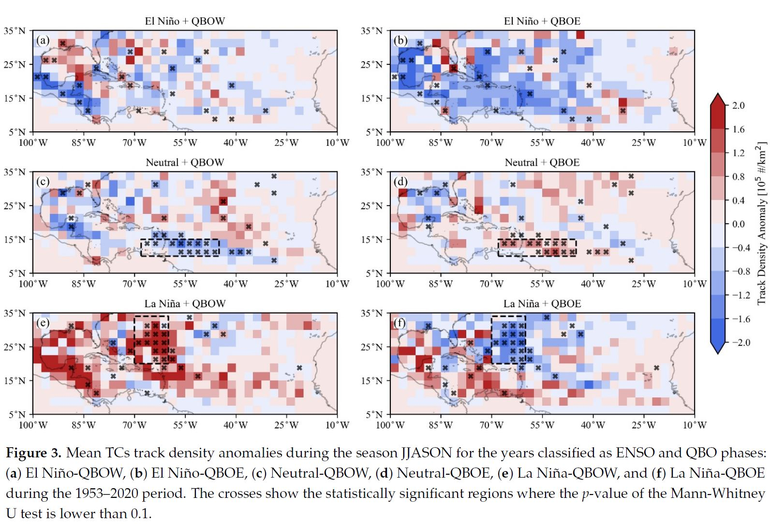
ENSO + QBO (Jaramillo et al., 2021)
Notes:
ENSO and Quasi-biennial Oscillation of the stratosphere from June to November (1953-2020)
Showing TC track density anomalies during the different combinations of phases.

Slide 14
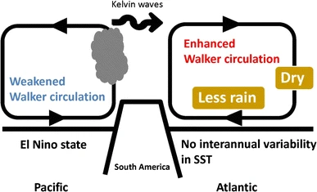
Walker Variation
Pacific Walker circulation is weakened (El Nino)
Enhanced Atlantic Walker circulation
Characterized by
Upper-level westerlies
Strengthened low-level easterlies
Anomalous dry, downward winds over the equatorial Atlantic
Drives other variable anomalies
Source: Sasaki et al., 2015
Notes:
During El Nino the pacific walker circulation is weakened, the momentum is carried by kelvin waves (mentioned in one source without sufficient description to relay)
Leads to Enhanced Atlantic walker circulation characterized by strengthened low-level easterlies, upper-level westerlies and anomalous dry, downward winds over the equatorial Atlantic

Slide 15
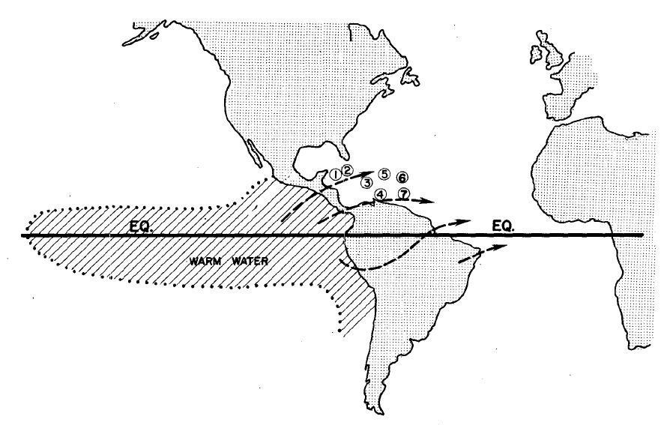
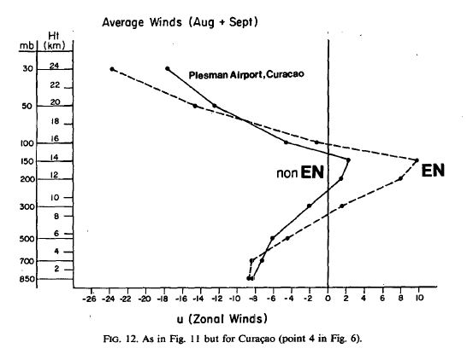
Vertical Wind Shear
Enhanced deep convection in the eastern pacific during El Nino develops anomalous upper tropospheric outflow patterns
Produces an enhancement of upper-level westerly winds over the Caribbean.
Source: Gray, 1984
Notes:
Most widely talked about variable with influence of ENSO to TC activity
First introduced by gray 1984 – El nino increasing vertical wind shear
Talks about how enhanced deep convection in the eastern pacific during El Nino develops anomalous upper tropospheric outflow patterns
This produces an enhancement of the westerly winds over the Caribbean
Top figure shows 200hpa outflow patterns due to enhanced deep-cumulus convection in the eastern tropical Pacific during moderate and strong El Nino years
Bottom figure shows averaged august and September winds with altitude over curacao for el nino and non el nino years
Here there is a clear anomaly of westerly winds around 200-150mb

Slide 16
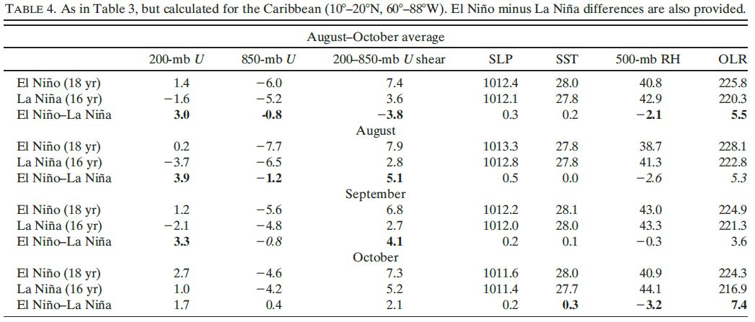
Klotzbach, 2011 (2)
Notes:
Klotzbach has also compiled statistics on vertical wind shear using NCEP-NCAR Reanalysis for ASO ESNO phases inside the Caribbean.
Shows there is a much larger shear during El Nino phases than during La Nina phases
Also shows averaged SLP, SST, 500mb RH and outgoing longwave radiation for the relative phases, which are similar in magnitude

Slide 17
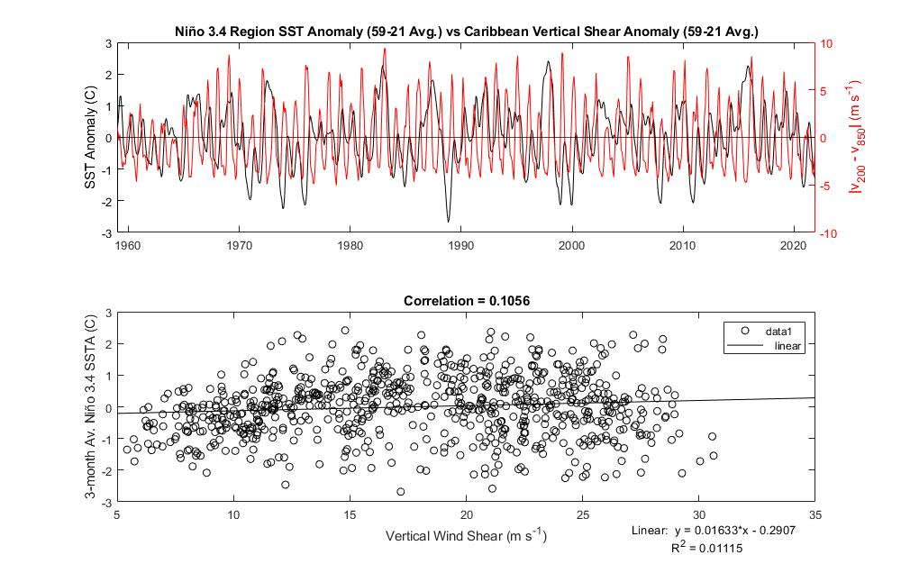
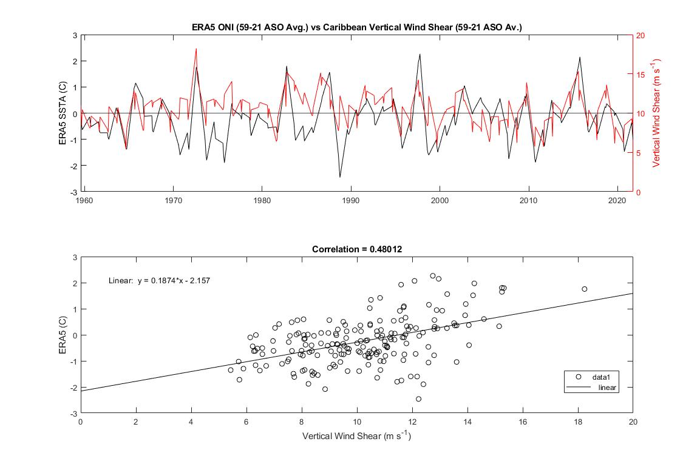
Vertical Wind Shear – ERA5 Reanalysis
Full Time Series vs. August - October
Notes:
Using the Klotzbach domain I looked at the relationship between the ONI and Vertical wind shear in ecmwf reanalysis
Looking at the full time series on the left shows little correlation between the two
Filtering for ASO hurricane season (right) allows correlation to emerge

Slide 18
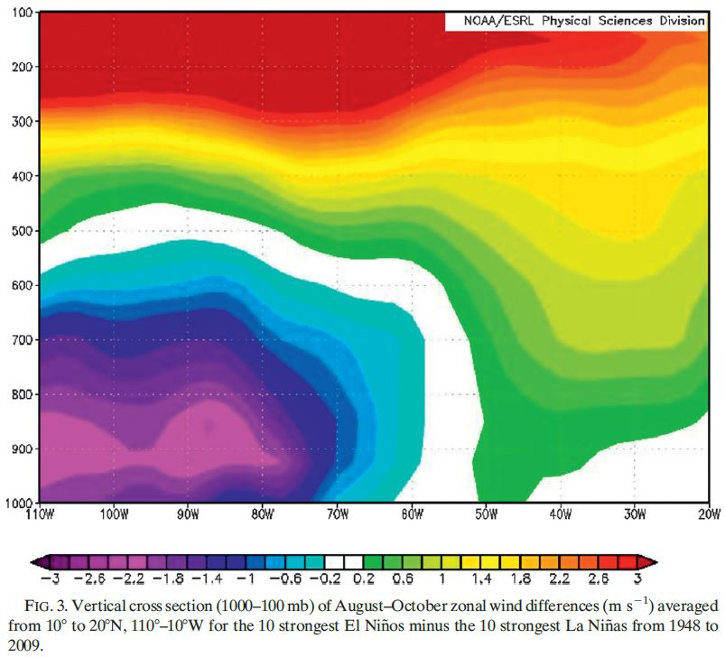
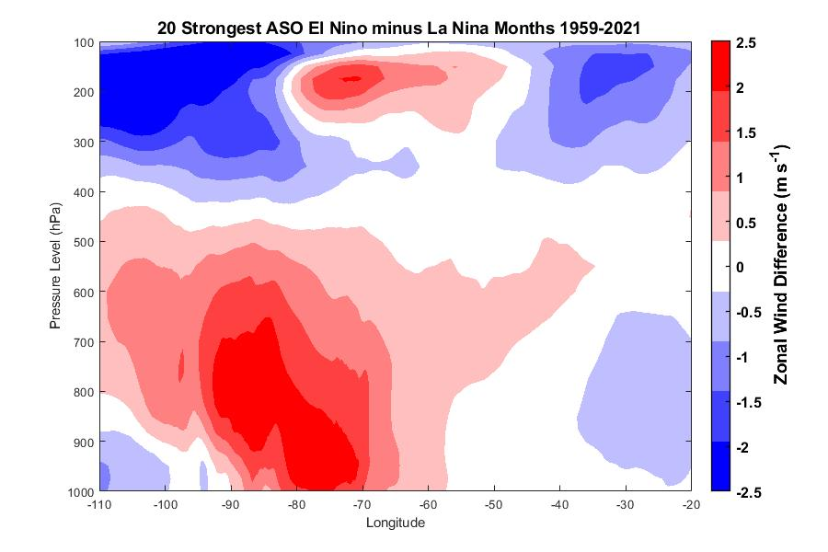
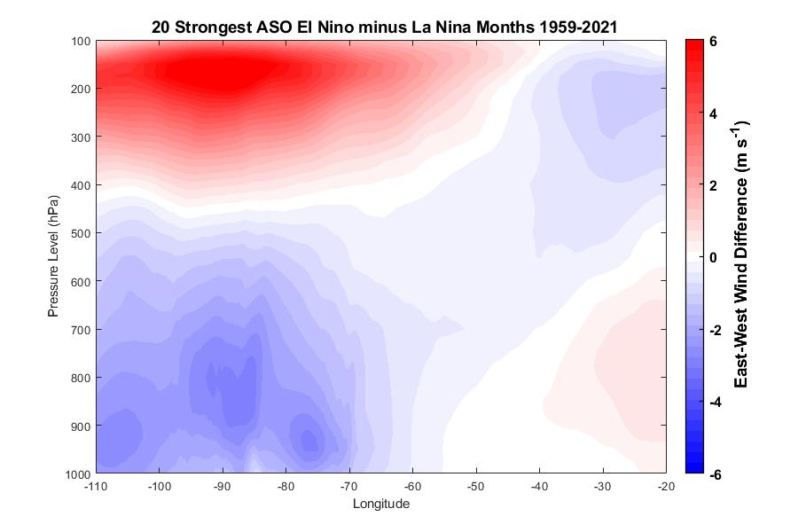
Klotzbach, 2011 (2)
Vertical cross section of the 10 strongest El Niños minus the 10 strongest La Niñas from 1000 to 100 mb averaged from 10 to 20N from the eastern Pacific into the tropical Atlantic.
In the Caribbean, anomalous easterlies at low levels and stronger westerlies at upper levels and the consequent increase in the vertical shear over this region.
Further east in the tropical Atlantic, defined as 10–20N, 20–60W, upper-level westerlies are somewhat stronger in El Nino years than in either neutral or La Nina years
Notes:
Variability of winds in a vertical cross section with Reanalysis
Top figure shows the zonal wind anomaly from 1000 to 100hpa, from 110W to 20W and this was averaged from 10N to 20N
This is the average values from the 10 strongest El Niño phases minus the 10 strongest la Nina phases
Shows anomalous upper-level westerlies and lower-level easterlies over the Caribbean
Bottom left shows my attempt at reproducing this cross section using zonal wind anomalies from ERA5 reanalysis, but the result is completely different
The bottom right show only the east-west wind component with the same averaging scheme, which shows a similar result to the one of Klotzbach
However, the information on this cross section was not so clearly defined within the paper

Slide 19
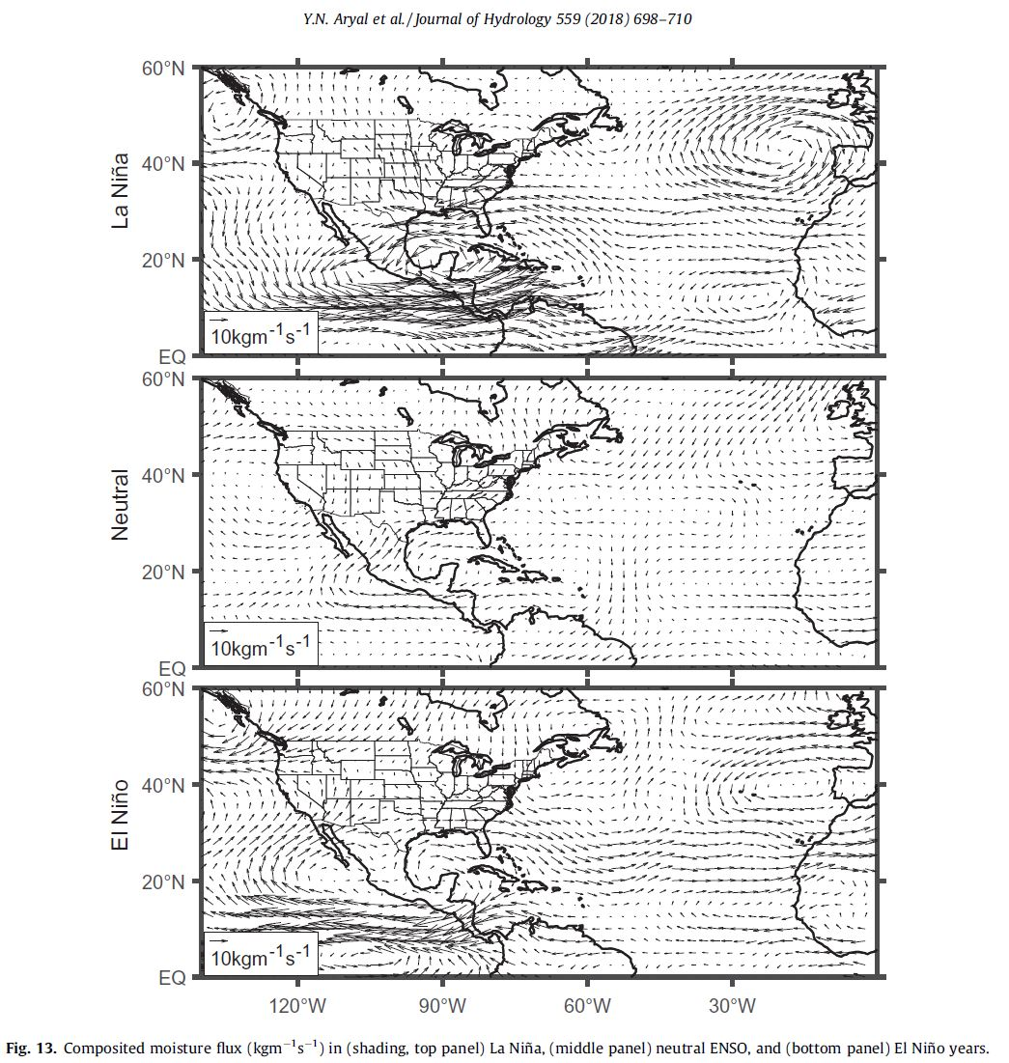
Moisture Flux – Aryal et al., 2018/Patricola et al., 2014
The moisture flux transport during La Niña years features a path into the Caribbean from the pacific and up into the Gulf of Mexico
Moisture flux anomalies are much weaker during El Niño years and the pat his away from the Caribbean
Moisture flux anomalies during neutral ENSO phases are weak.
Patricola et al. (2014) found that mid-tropospheric moisture as a thermodynamic impact plays an equally important role compared to vertical wind shear in Atlantic TC activity.
Notes:
The moisture flux into and out of the Caribbean in correlation with ENSO phase.
The figure shows the composited moisture flux for different phases of ENSO
The top panel shows moisture flux transport during La Nina years features a strong path into the Caribbean from the pacific and up into the GoM
Comparing with moisture fluxes during el nino years in the bottom panel we see the anomalies are much weaker and the path is away from the Caribbean
The moisture flux anomalies are very weak during neutral ENSO phases as shown in the middle panel

Slide 20
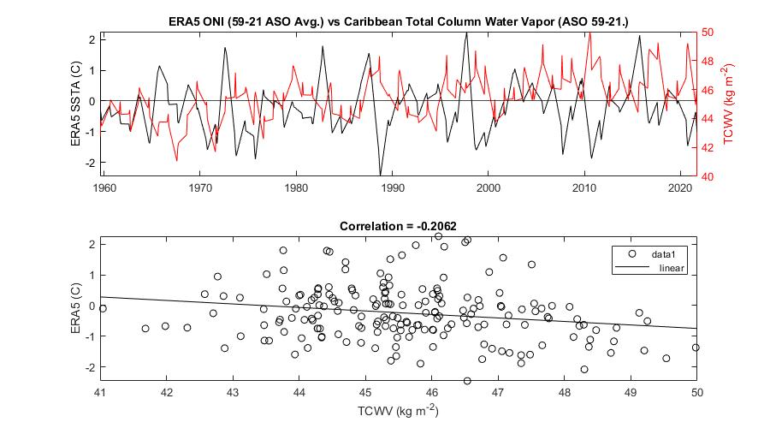
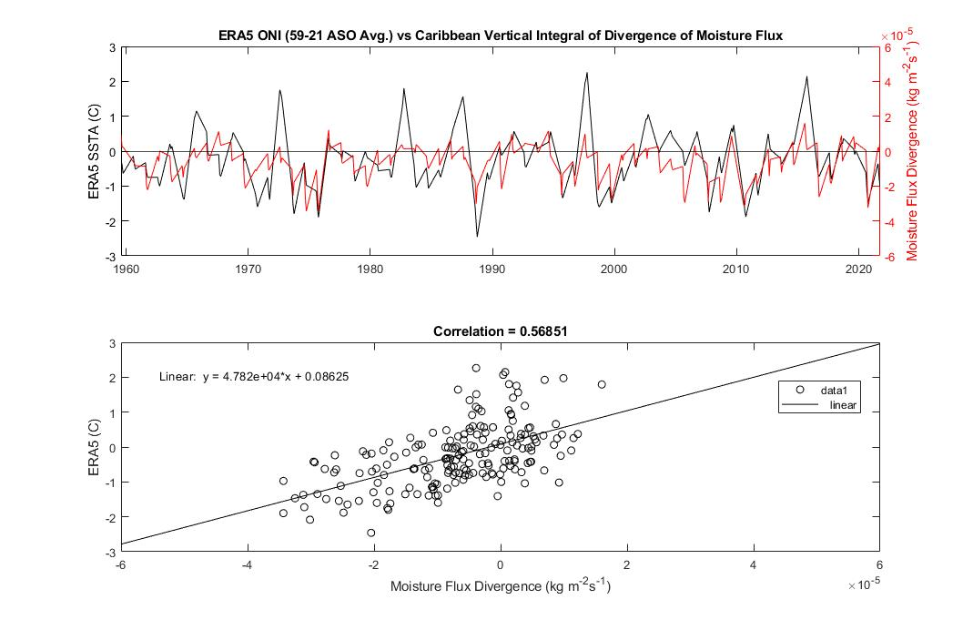
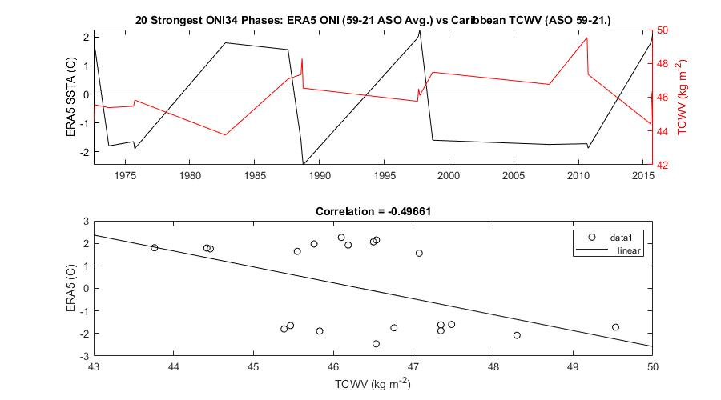
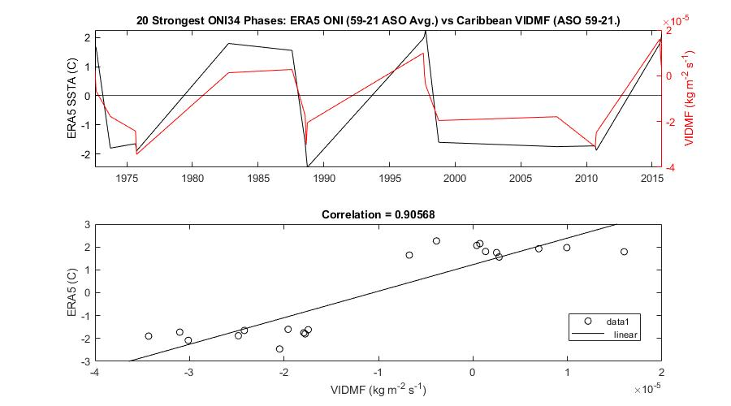
Notes:
Looking at the reanalysis we see some interesting correlations with water vapor and moisture flux
Top left shows era5 ONI timeseries with TCWV during only ASO months, plotting these against each other there is a respectable correlation between the two
However, if we isolate the 10 strongest warm phase months and 10 strongest cold phase months, we see there is a significant increase in correlation between the parameters
So increased water vapor during cold phases and decreased during warm phases.
Top right panel shows VIDMF vs ERA5 ONI for ASO months, where we have a correlation of 0.57 between the two
And if we isolate the strongest phases such as with water vapor, we see the correlation increases to 0.9 between the ONI and VIDMF
So more divergence during warm phases and more convergence during cold phases
The vertical integral of the moisture flux is the horizontal rate of flow of moisture, per meter across the flow, for a column of air extending from the surface of the Earth to the top of the atmosphere. Its horizontal divergence is the rate of moisture spreading outward from a point, per square meter. This parameter is positive for moisture that is spreading out, or diverging, and negative for the opposite, for moisture that is concentrating, or converging (convergence). This parameter thus indicates whether atmospheric motions act to decrease (for divergence) or increase (for convergence) the vertical integral of moisture. 1 kg of water spread over 1 square meter of surface is 1 mm deep (neglecting the effects of temperature on the density of water), therefore the units are equivalent to mm (of liquid water) per second.

Slide 21
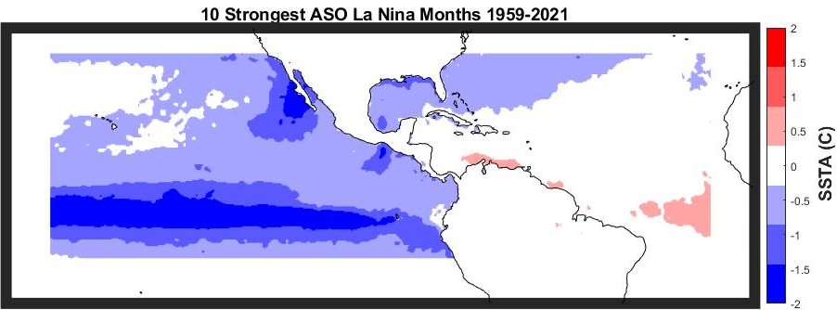
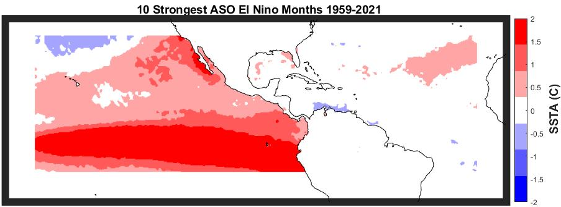
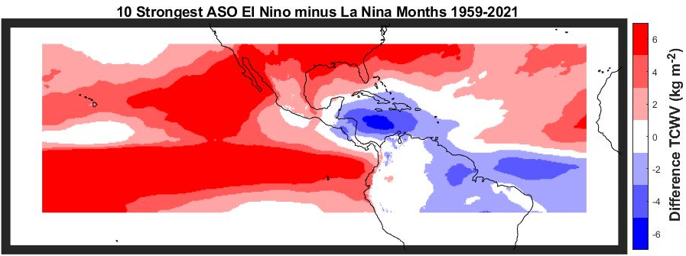
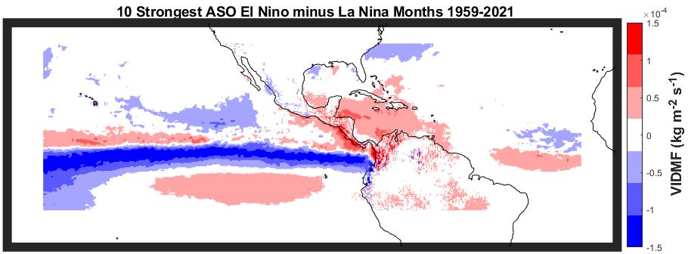
Notes:
On the top left we have the average SSTA from the 10 coldest months 1959-2021
Top right shows the average SSTA from the 10 warmest month during the same period
Bottom left we have the TCWV from 10 warmest months minus the 10 coldest months
- This shows more water vapor in the Caribbean during la nina months than El Nino months
Bottom right shows the VIDMF from 10 warmest months minus the 10 coldest months
- This shows more DIVERGENCE during El Nino and more CONVERGENCE during La Nina

Slide 22
Conclusions
The ENSO teleconnections and impacts on Atlantic hurricane activity can be substantially masked or accentuated by the leading multidecadal modes (AMO + QBO).
These modes provide a substantially more complete view of the climate control over Atlantic hurricane activity during individual seasons than is afforded by ENSO alone.
ENSO causes changes in cyclogenesis frequency – both in total storm systems and major hurricanes
Changes in TC frequency can be attributed to strong correlations between ENSO phase with vertical wind shear, Total Column Water Vapor and Moisture Flux Divergence during the August-October months.
These teleconnections become even more pronounced when isolating particularly strong phases.
Understanding the relationship between ENSO and the Walker circulation, and how the change in Walker circulation affects the relevant variables in the Atlantic/Caribbean completes the connection between ENSO and Atlantic TC activity

Slide 23
Sources
Aryal, Y. N., Villarini, G., Zhang, W., & Vecchi, G. A. (2018). Long term changes in flooding and heavy rainfall associated with North Atlantic tropical cyclones: Roles of the North Atlantic Oscillation and El Niño-Southern Oscillation. Journal of Hydrology, 559, 698-710.
Barlow, M., Nigam, S., & Berbery, E. H. (1998). Evolution of the North American Monsoon System, Journal of Climate, 11(9), 2238-2257.
Bell, G. D., & Chelliah, M. (2006). Leading Tropical Modes Associated with Interannual and Multidecadal Fluctuations in North Atlantic Hurricane Activity, Journal of Climate, 19(4), 590-612
Bister, M., Emanuel, K.A. Dissipative heating and hurricane intensity. Meteorl. Atmos. Phys. 65, 233–240 (1998). https://doi.org/10.1007/BF01030791
Bister, M., and K. A. Emanuel, Low frequency variability of tropical cyclone potential intensity, 1, Interannual to interdecadal variability, J. Geophys. Res., 107(D24), 4801, doi:10.1029/2001JD000776, 2002.
Emanuel, K. A. (1995). Sensitivity of Tropical Cyclones to Surface Exchange Coefficients and a Revised Steady-State Model incorporating Eye Dynamics, Journal of Atmospheric Sciences, 52(22), 3969-3976.
Emanuel, Kerry & Nolan, David. (2004). Tropical cyclone activity and global climate. Bulletin of the American Meteorological Society. 85.
Frank, W. M., & Young, G. S. (2007). The Interannual Variability of Tropical Cyclones, Monthly Weather Review, 135(10), 3587-3598.
Goldenberg, S. B., & Shapiro, L. J. (1996). Physical Mechanisms for the Association of El Niño and West African Rainfall with Atlantic Major Hurricane Activity, Journal of Climate, 9(6), 1169-1187.
Gray, W. M. (1984). Atlantic Seasonal Hurricane Frequency. Part I: El Niño and 30 mb Quasi-Biennial Oscillation Influences, Monthly Weather Review, 112(9), 1649-1668.
Hersbach, H., Bell, B., Berrisford, P., Biavati, G., Horányi, A., Muñoz Sabater, J., Nicolas, J., Peubey, C., Radu, R., Rozum, I., Schepers, D., Simmons, A., Soci, C., Dee, D., Thépaut, J-N. (2018): ERA5 hourly data on single levels from 1959 to present. Copernicus Climate Change Service (C3S) Climate Data Store (CDS). 10.24381/cds.adbb2d47
Hersbach, H., Bell, B., Berrisford, P., Biavati, G., Horányi, A., Muñoz Sabater, J., Nicolas, J., Peubey, C., Radu, R., Rozum, I., Schepers, D., Simmons, A., Soci, C., Dee, D., Thépaut, J-N. (2018): ERA5 hourly data on pressure levels from 1959 to present. Copernicus Climate Change Service (C3S) Climate Data Store (CDS). 10.24381/cds.bd0915c6
Hersbach, H., Bell, B., Berrisford, P., Biavati, G., Horányi, A., Muñoz Sabater, J., Nicolas, J., Peubey, C., Radu, R., Rozum, I., Schepers, D., Simmons, A., Soci, C., Dee, D., Thépaut, J-N. (2019): ERA5 monthly averaged data on single levels from 1959 to present. Copernicus Climate Change Service (C3S) Climate Data Store (CDS). 10.24381/cds.f17050d7
Jaramillo, A.; Dominguez, C.; Raga, G.; Quintanar, A.I. The Combined QBO and ENSO Influence on Tropical Cyclone Activity over the North Atlantic Ocean. Atmosphere 2021, 12, 1588. https://doi.org/10.3390/atmos12121588
Klotzbach, P. J. (2011). The Influence of El Niño–Southern Oscillation and the Atlantic Multidecadal Oscillation on Caribbean Tropical Cyclone Activity, Journal of Climate, 24(3), 721-731.
Klotzbach, P. J. (2011). El Niño–Southern Oscillation’s Impact on Atlantic Basin Hurricanes and U.S. Landfalls, Journal of Climate, 24(4), 1252-1263.
Krishnamurthy, L., Vecchi, G. A., Msadek, R., Murakami, H., Wittenberg, A., & Zeng, F. (2016). Impact of Strong ENSO on Regional Tropical Cyclone Activity in a High-Resolution Climate Model in the North Pacific and North Atlantic Oceans, Journal of Climate, 29(7), 2375-2394.
Landsea, C. (2000). El Niño/Southern Oscillation and the Seasonal Predictability of Tropical Cyclones. In H. Diaz & V. Markgraf (Eds.), El Niño and the Southern Oscillation: Multiscale Variability and Global and Regional Impacts (pp. 149-182). Cambridge: Cambridge University Press. doi:10.1017/CBO9780511573125.006
Lim, Y., Schubert, S. D., Reale, O., Molod, A. M., Suarez, M. J., & Auer, B. M. (2016). Large-Scale Controls on Atlantic Tropical Cyclone Activity on Seasonal Time Scales, Journal of Climate, 29(18), 6727-6749.
Patricola, C. M., Saravanan, R., & Chang, P. (2014). The Impact of the El Niño–Southern Oscillation and Atlantic Meridional Mode on Seasonal Atlantic Tropical Cyclone Activity, Journal of Climate, 27(14), 5311-5328.
Rodríguez, A. O., & Butts Jr, D. A. An Examination of the Impact of ENSO Phases on Gulf Coast Tropical Cyclones.
Sasaki, W., Doi, T., Richards, K.J. et al. The influence of ENSO on the equatorial Atlantic precipitation through the Walker circulation in a CGCM. Clim Dyn 44, 191–202 (2015). https://doi.org/10.1007/s00382-014-2133-5
Tang, B. H., and Neelin, J. D. (2004), ENSO Influence on Atlantic hurricanes via tropospheric warming, Geophys. Res. Lett., 31, L24204, doi:10.1029/2004GL021072.
Wang, C. Variability of the Caribbean Low-Level Jet and its relations to climate. Clim Dyn 29, 411–422 (2007). https://doi.org/10.1007/s00382-007-0243-z
Zhu, X., Saravanan, R., & Chang, P. (2012). Influence of Mean Flow on the ENSO–Vertical Wind Shear Relationship over the Northern Tropical Atlantic, Journal of Climate, 25(3), 858-864.
https://www.cpc.ncep.noaa.gov/products/analysis_monitoring/ensocycle/enso_cycle.shtml
https://scijinks.gov/hurricane/
https://climatedataguide.ucar.edu/climate-data/nino-sst-indices-nino-12-3-34-4-oni-and-tni
https://www.ncei.noaa.gov/access/monitoring/enso/sst
https://origin.cpc.ncep.noaa.gov/products/analysis_monitoring/ensostuff/detrend.nino34.ascii.txt

